Slide 1


NEXT GEN EMPLOYABILITY PROGRAM
CREATING A FUTURE-READY WORKFORCE
Student Name :
CHANDAN CHOUDHURY
Student ID :
College Name :
STU6769782a1039f1734965290
C. V. Raman Global University

Slide 2
CAPSTONE PROJECT SHOWCASE
Project Title
Crowdfunding Platform with React and ExpressJS Framework (P1)
Abstract | Problem Statement | Project Overview | Proposed Solution | Technology Used | Modelling & Results | Conclusion | Q&A

Slide 3
Abstract
1
Crowdfunding Platform with React and ExpressJS is a web-based solution designed to facilitate secure and transparent fundraising for various causes, enabling users to create and manage campaigns seamlessly.
2
The platform features a React.js frontend for an intuitive user experience, while the Express.js and MongoDB backend ensures secure data handling and efficient campaign management.
3
Key functionalities include campaign creation, donation processing, real-time updates, admin dashboard for managing funds, and user authentication for secure transactions.
4
This project aims to enhance accessibility, trust, and efficiency in online fundraising by providing a robust and scalable solution for individuals and organizations.

Slide 4


Problem Statement
Crowdfunding is a vital tool for individuals, startups, and organizations to raise funds for various causes, yet existing platforms often suffer from high transaction fees, lack of transparency, and limited accessibility.
This project aims to address these challenges by developing a secure, transparent, and user-friendly crowdfunding platform that enables users to:
Create and manage campaigns easily.
Track donations in real-time for transparency.
Ensure secure payments with Paytm integration.
Use a modern tech stack with React, ExpressJS, and MongoDB for scalability.

Slide 5

Project Overview
A crowdfunding platform built with React (Frontend) and ExpressJS (Backend), using MongoDB for data storage.
Users can create, manage, and contribute to campaigns securely.
Admin dashboard for monitoring campaigns and donations.
Real-time tracking of funds raised for transparency.
Paytm integration for seamless payment processing.
Secure authentication with JWT for admin login.
User-friendly interface with responsive design.

Slide 6
Proposed Solution
Frontend Implementation (React.js)
Built using React.js for a dynamic and responsive user interface.
Utilized React Router for seamless navigation between pages.
Integrated state management for handling user interactions and campaign data.
Backend Development (Express.js & Node.js)
Developed with Express.js and Node.js to handle API requests efficiently.
Implemented RESTful APIs for campaign management, user authentication, and donation processing.
Used JWT-based authentication to secure admin and user logins.
Database (MongoDB Atlas)
Hosted on MongoDB Atlas for scalable and cloud-based data storage.
Structured data using Mongoose models for campaigns, users, and transactions.
Payment Gateway Integration
Paytm integration for seamless and secure online payments.
Transaction details stored and managed for transparency and accountability.
Additional Features
Admin Dashboard for monitoring donations and managing campaigns.
Real-time donation tracking to show the latest contributions.
Secure and scalable system designed to handle large user interactions efficiently.

Slide 7

Technology used
Frontend: Built using React.js for a dynamic user interface, React Router for navigation, and CSS Modules for styling.
Backend: Developed with Node.js and Express.js to handle API requests efficiently. JWT (JSON Web Token) is used for secure authentication and session management.
Database: MongoDB Atlas is used as a cloud database, with Mongoose to define and manage data models.
API & Security: CORS is enabled for cross-origin requests, Body-parser processes incoming requests, and Bcrypt.js ensures encrypted password storage.
Payment Integration: Integrate Paytm Payment Gateway for secure and seamless donation transactions.
Development & Deployment: APIs tested using Postman, version control managed through GitHub, frontend planned to host on Vercel, and backend deployment planned on Railway/Render.

Slide 8
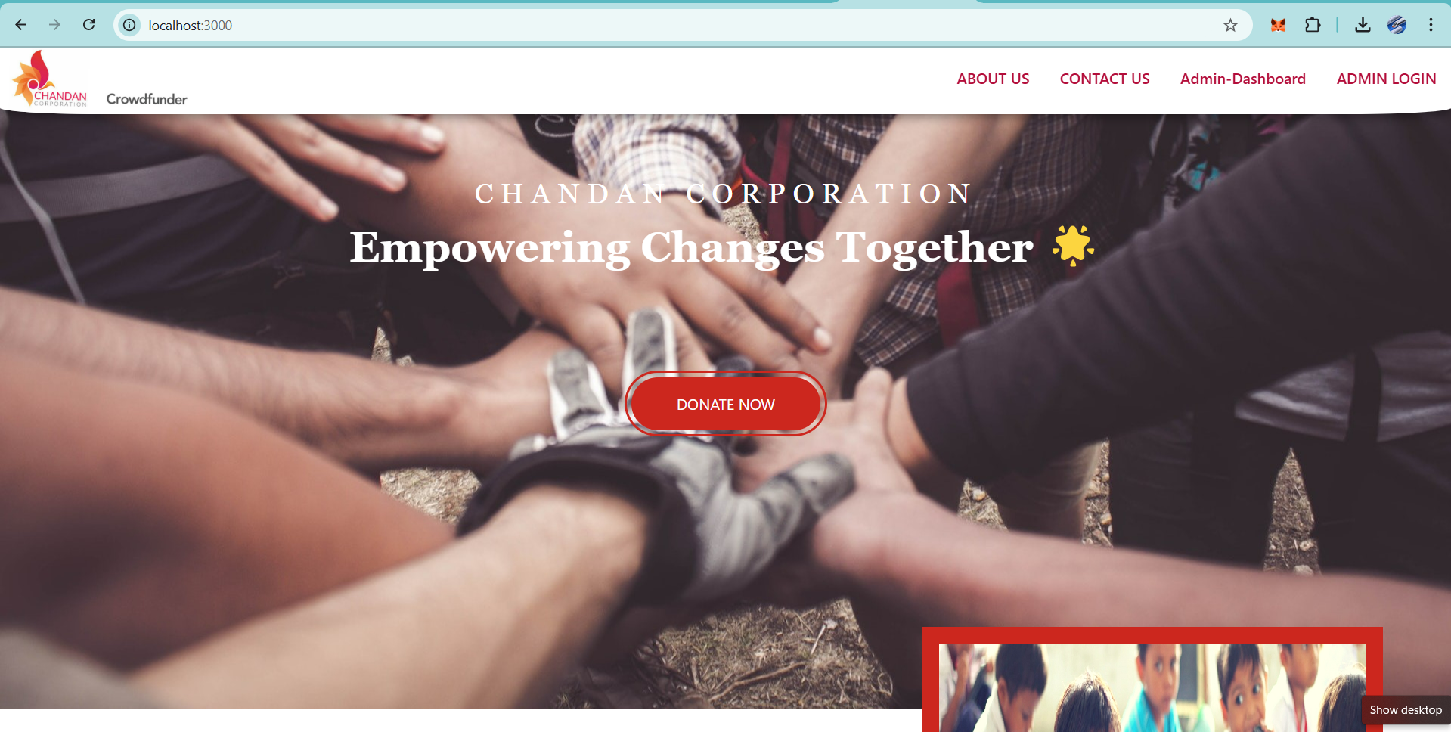
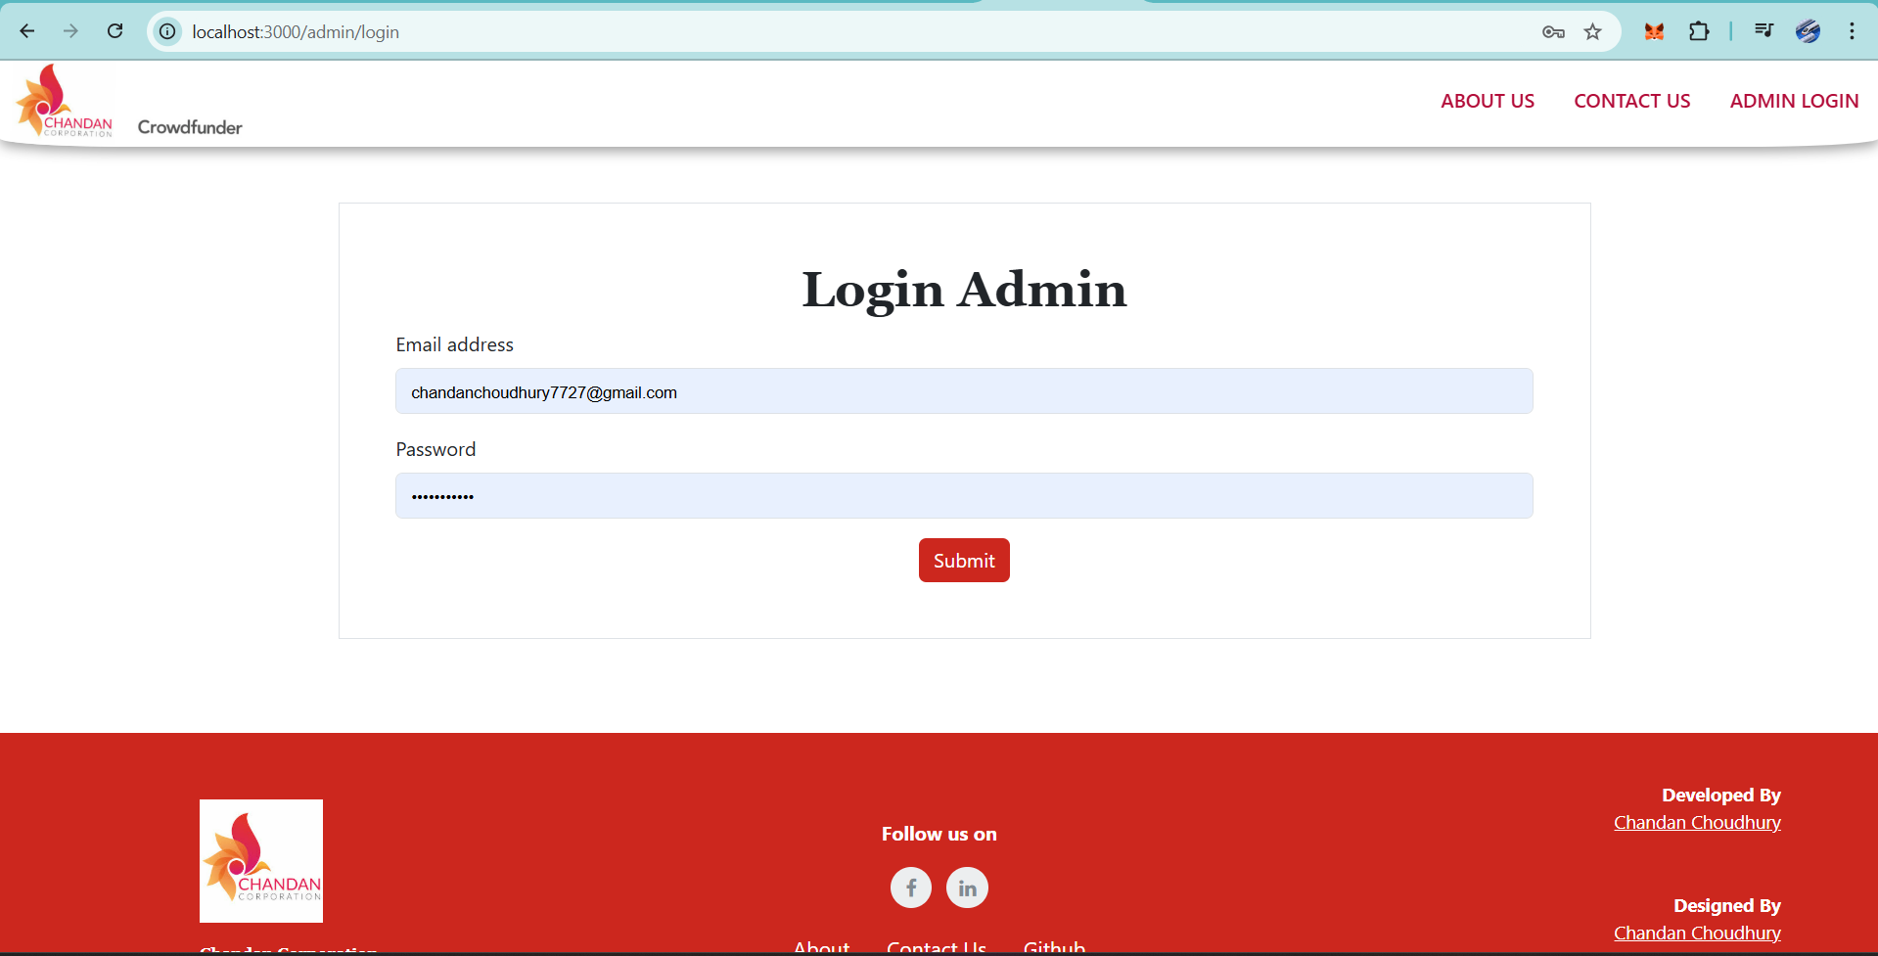
Modelling & Result
Home Page
Admin Login Page

Slide 9
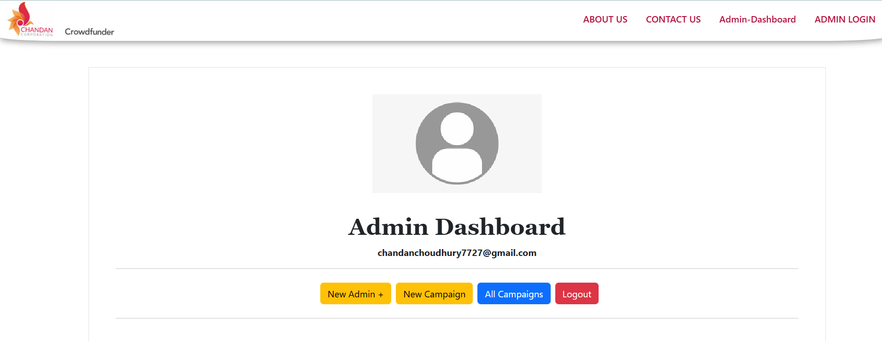
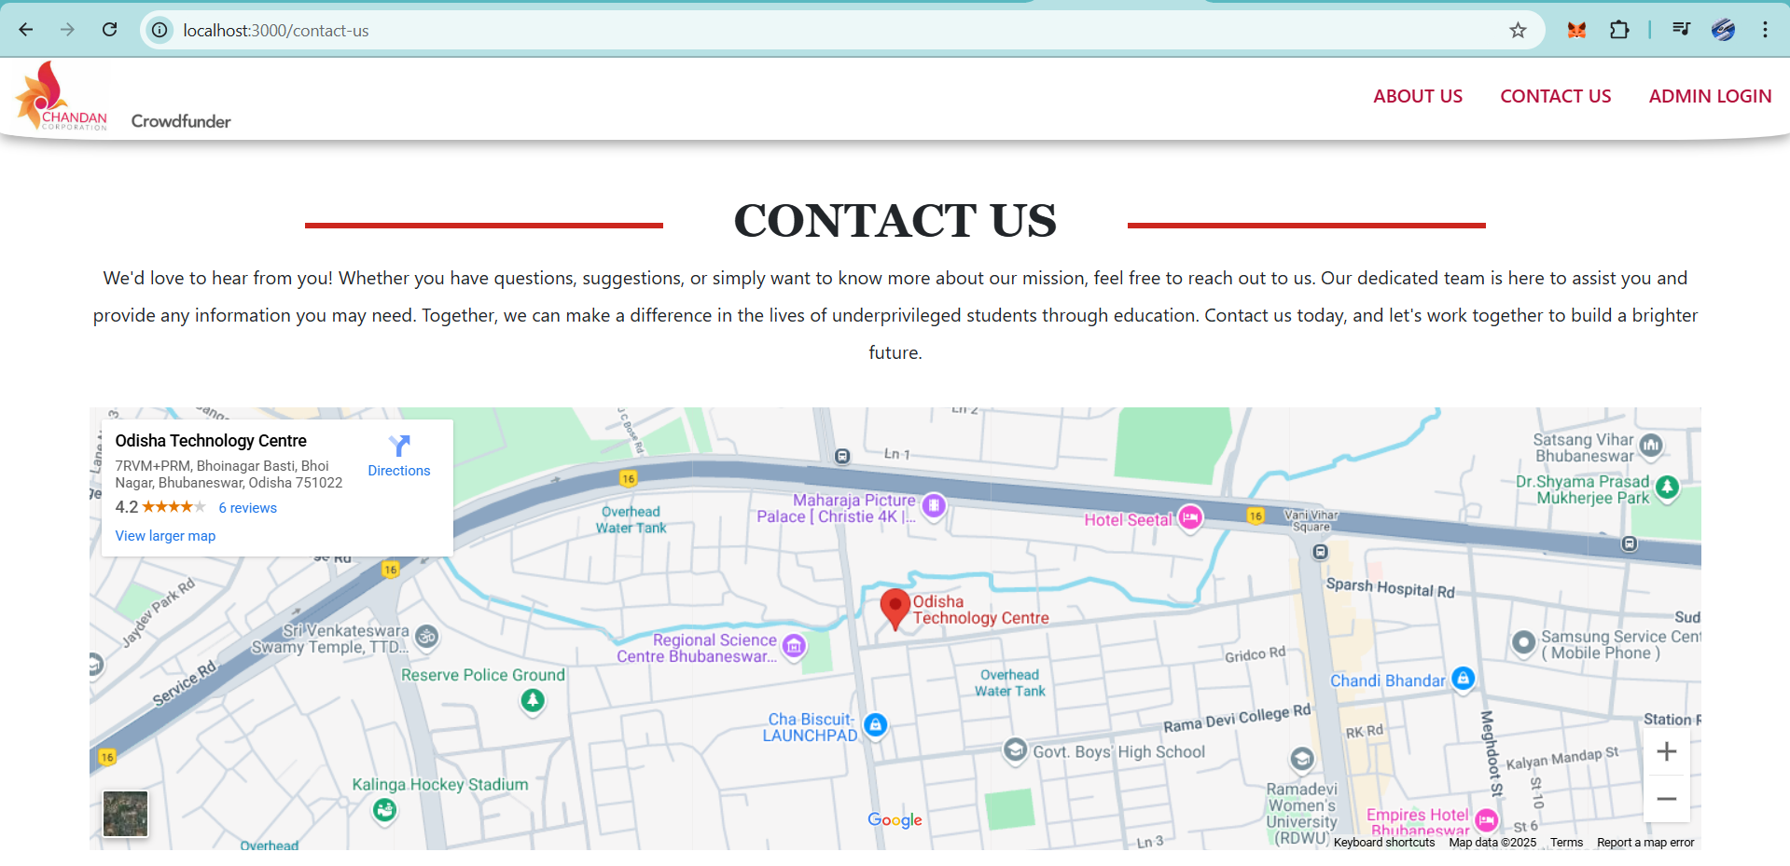
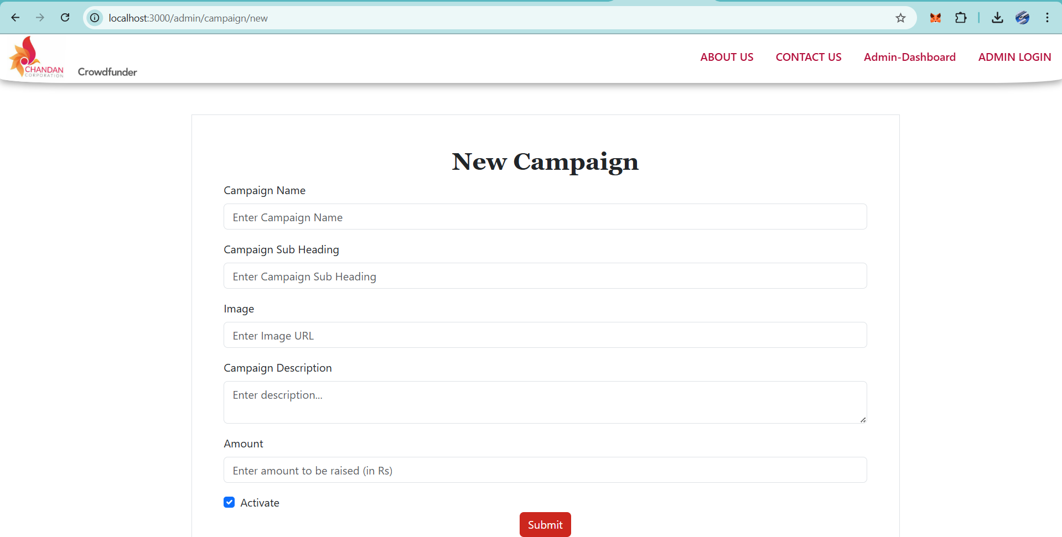
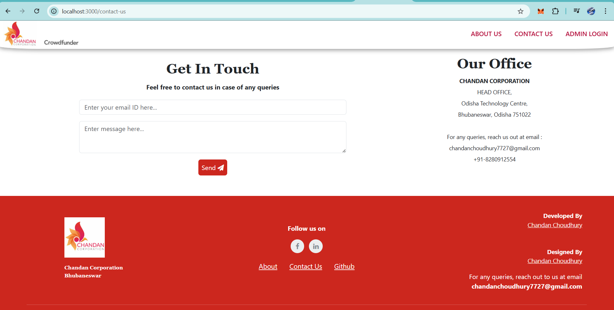
Modelling & Result
Admin Dashboard & New Campaign Creation Page
Contact Us Page

Slide 10
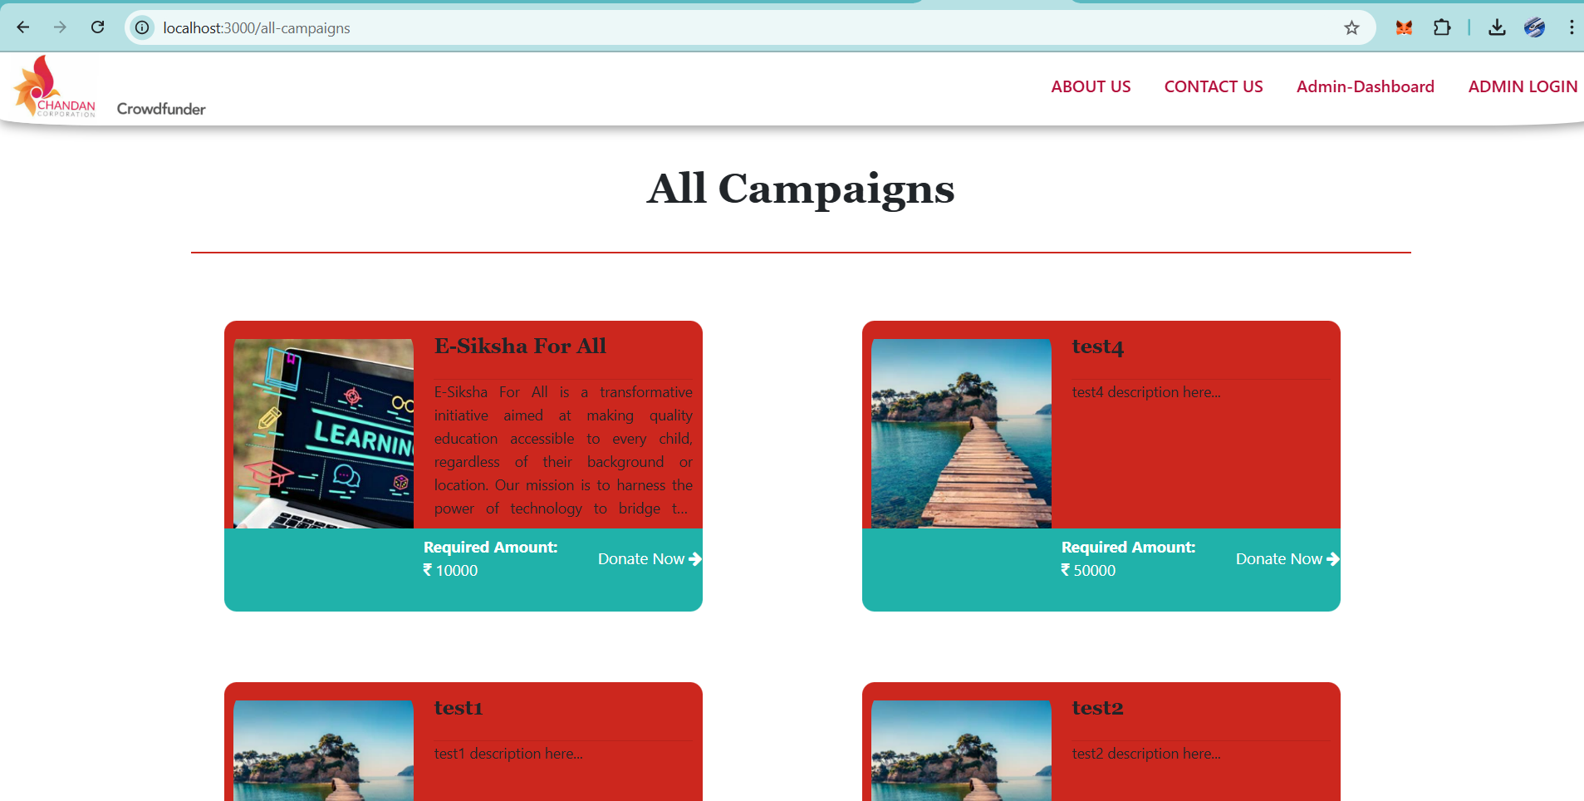
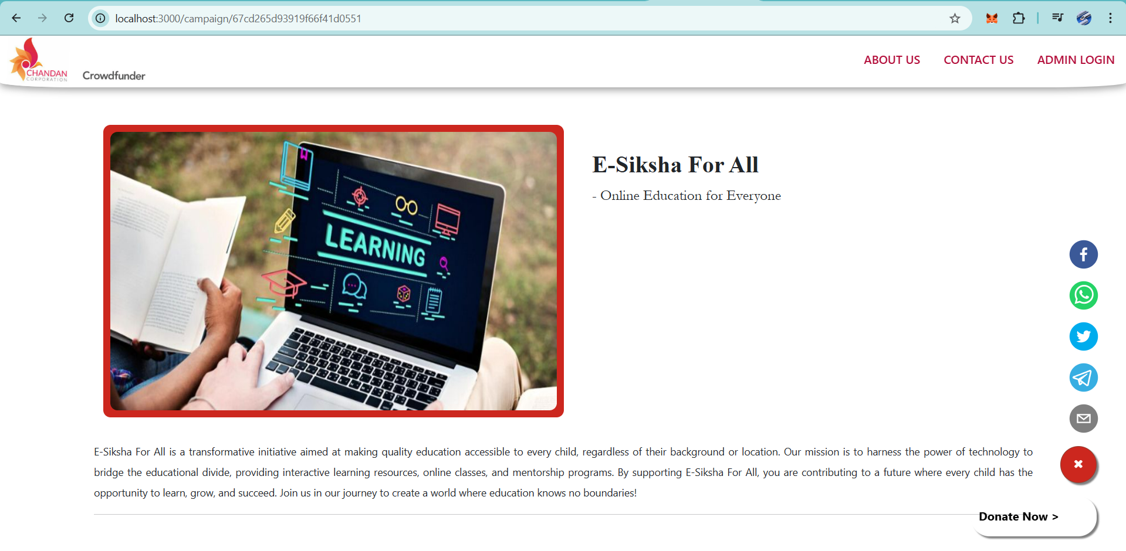
Modelling & Result
Donation Page: Clicking on Donate now →Donation Form → Paytm Payment Gateway
All Campaign’s Page

Slide 11

Conclusion
This crowdfunding platform provides a seamless and secure way to support campaigns, ensuring transparency and ease of use.
With React.js for frontend, Express.js & Node.js for backend, and MongoDB Atlas for data storage, the system ensures a scalable and efficient architecture.
Paytm payment gateway integration for secure transactions.
This project demonstrates the power of modern web technologies in building a user-friendly and impactful crowdfunding solution.

Slide 12


Notes:
Thank You !!

